Slide 1
Steps Lock System In Buses
TEAM MEMBERS
REG.NO | NAME
111622102105 | N.HARSHITHA
111622102103 | L.NARMADHA
111622102102 | H.MYTHELI
111622102111 | P.MISRITHA REDDY
111622102107 | S>NIKHITHA

Slide 2
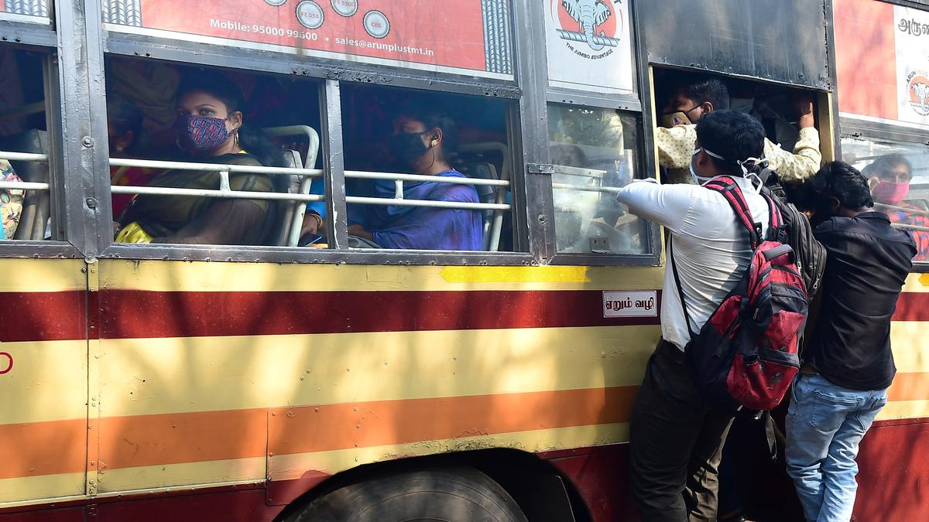
Cause
Many accidents happen when passengers are picked up boarding in buses.
When passengers missed their bus, they chase the running bus to get into it.
And also many accidents happen caused by footboard travel in buses .
A Significant number of passengers die each year from this accidents.
In 2022 , An 18-year-old college student was crushed to death after
accidentally falling from a Metropolitan Transport Corporation (MTC)
bus while travelling on the footboard

Slide 3
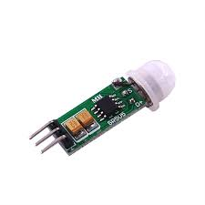
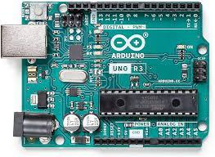
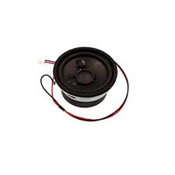
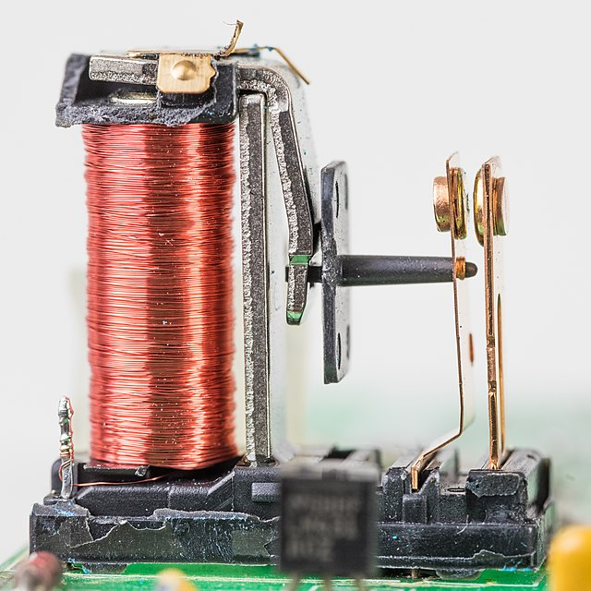
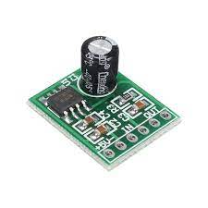
Technologies used
Arduino board
PIR sensor
Speakers
Relay
Audio Board

Slide 4
References
As by reference made from the literature It is possible that less attention is paid to the significance of crashes involving buses because the safety level of bus systems is considered to be adequate.
We got idea from this literature by using an algorithm able to calculate the Level of Safety of bus stops was defined, starting from the concept of Risk as a combination of Probability and Damage.
As by reference made from that literature system is designed in such a way that the whole system is quite modular so that it is easy to add extra features such as tamper-proofing, extending the system with retarder.

Slide 5
This methodology produce a modeling of the safety perception of intercity bus public transportation. Determine the most important factors among the parameters that affect the safety of intercity bus public transportation
As by reference by this lecture Foot board accident prevention system-using Hall effect sensor.
In this literature they using that project monitors the people on the footboard and also send information to the authority. This project also senses the blind spot region of the bus and sends the information to the driver.

Slide 6
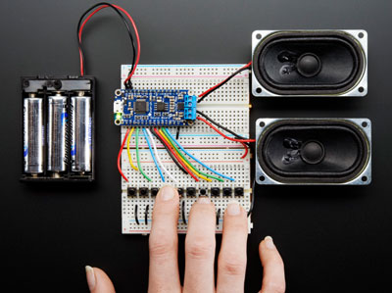
Final Product

Slide 7
THANK YOU

